Slide 1

Books
By team L

Slide 2
Books are awesome!
We didn’t want to steal any books, so all of the books that we used are part of the public domain.
We had 193 books by 12 different authors (Austen, Dickens, Doyle, Emerson, Hawthorne, Keats, Melville, Milton, Poe, Shakespeare, Twain, Wilde).
After running initially we added 46 books and 4 more authors (Wells, Wharton, Thoreau, Carroll).
We also only used authors that wrote their books in English, so not have to worry about different translations.

Slide 3
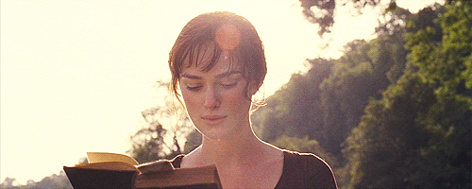
Why classify authors?
To combat plagiarism, and some authors taking credit for work that is not their own.
To figure out if a famous author has a pen name that they used to write other books.
To possibly identify ghost writers that many famous people use to write their books.

Slide 4
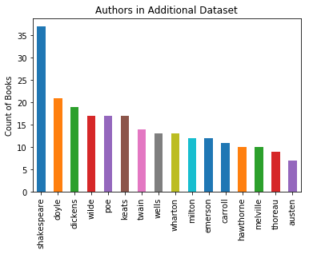
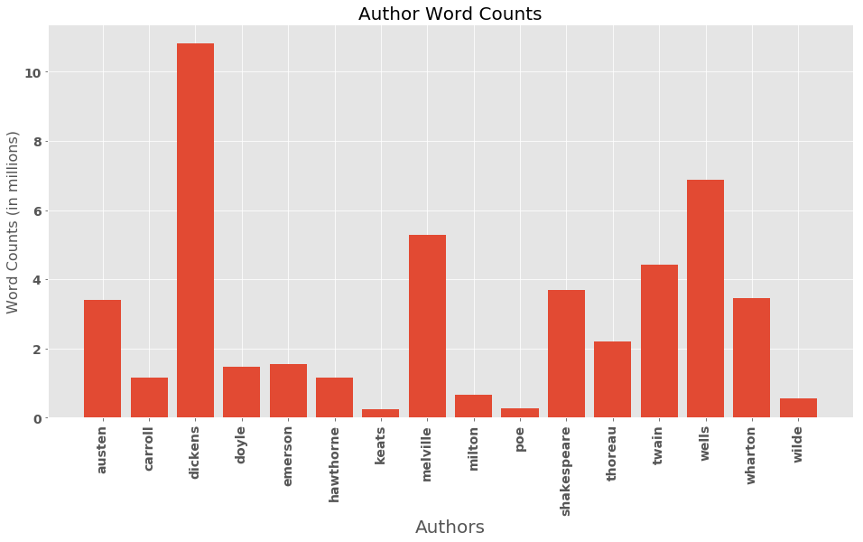
Count of books and words by Author

Slide 5
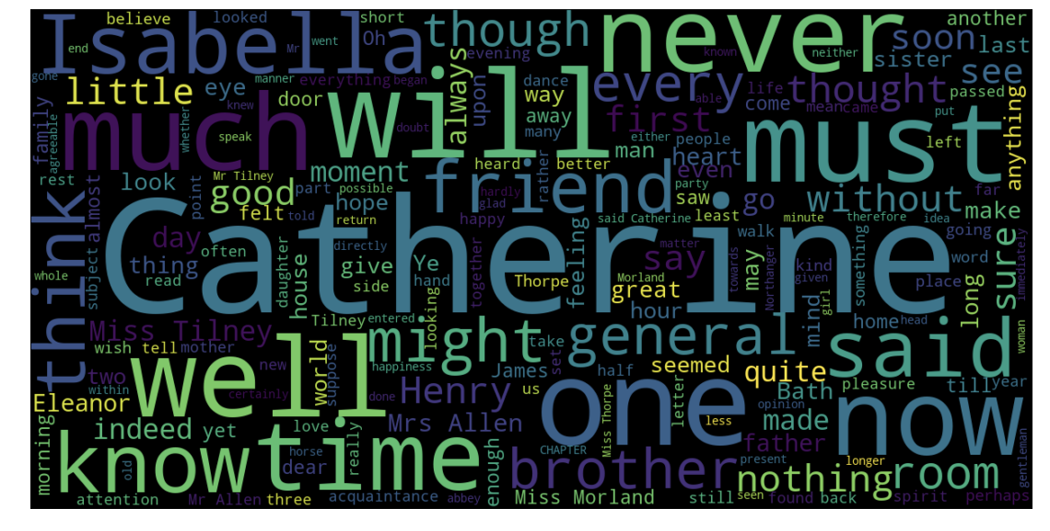
Wordcloud - Austen

Slide 6
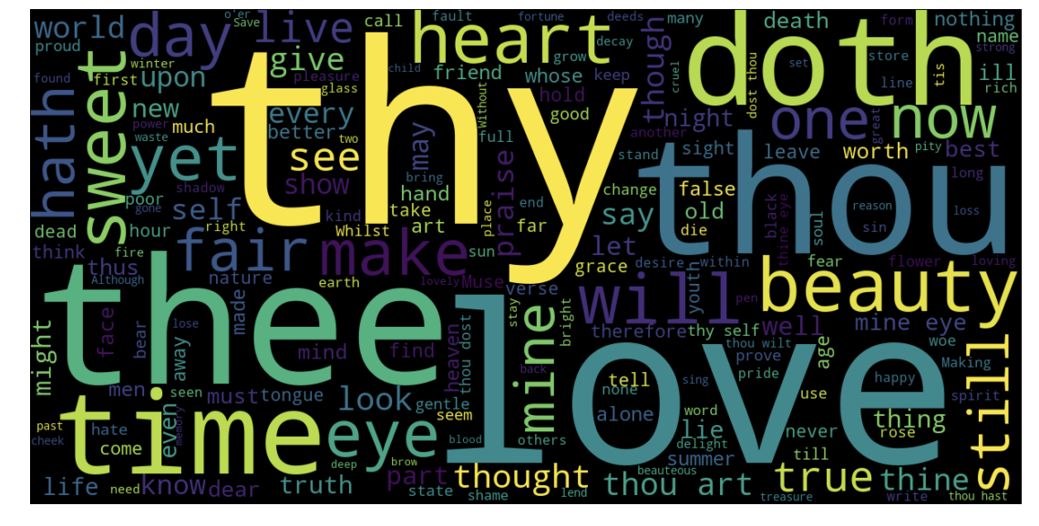
Wordcloud - Shakespeare

Slide 7
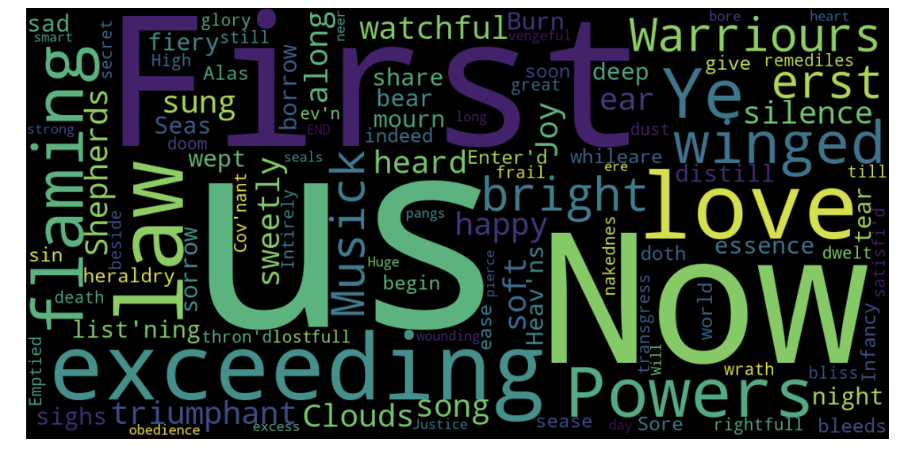
Wordcloud - Milton

Slide 8
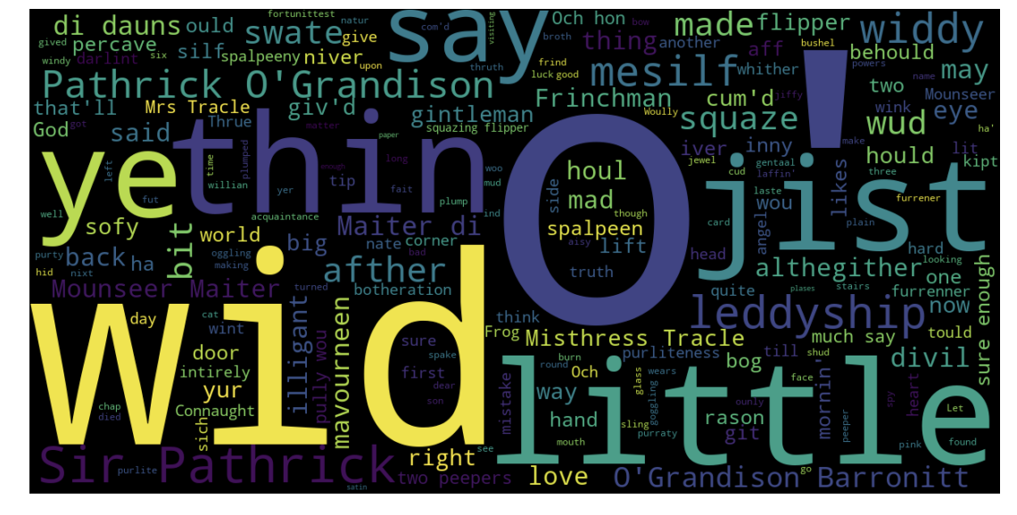
Wordcloud - Poe

Slide 9
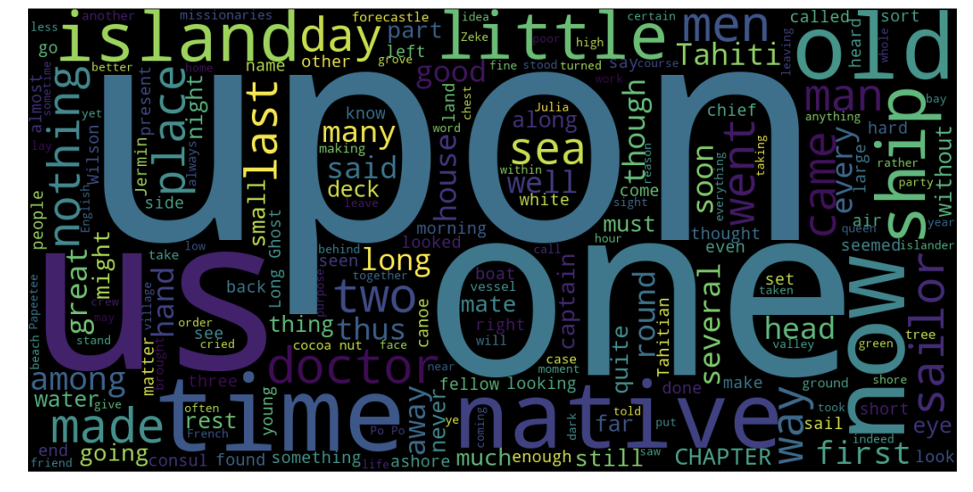
Wordcloud - Melville

Slide 10
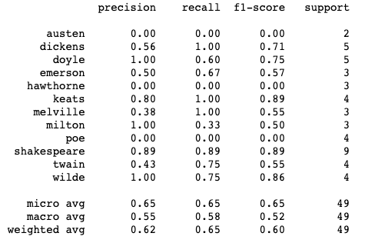
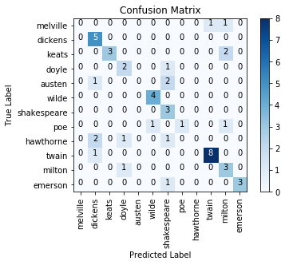
Naive Bayes

Slide 11
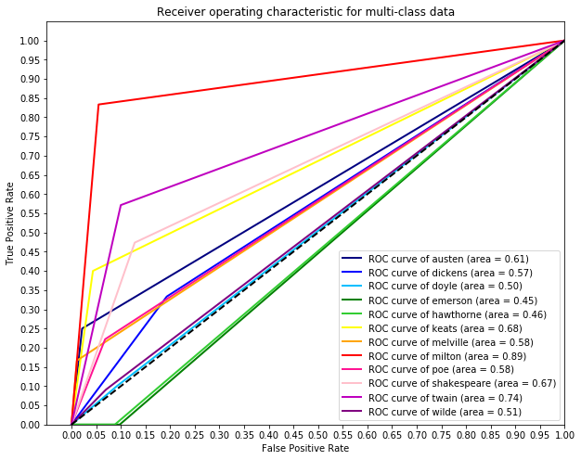
Naive Bayes

Slide 12
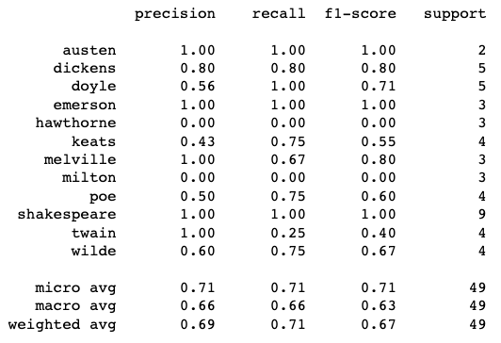

Random Forest

Slide 13
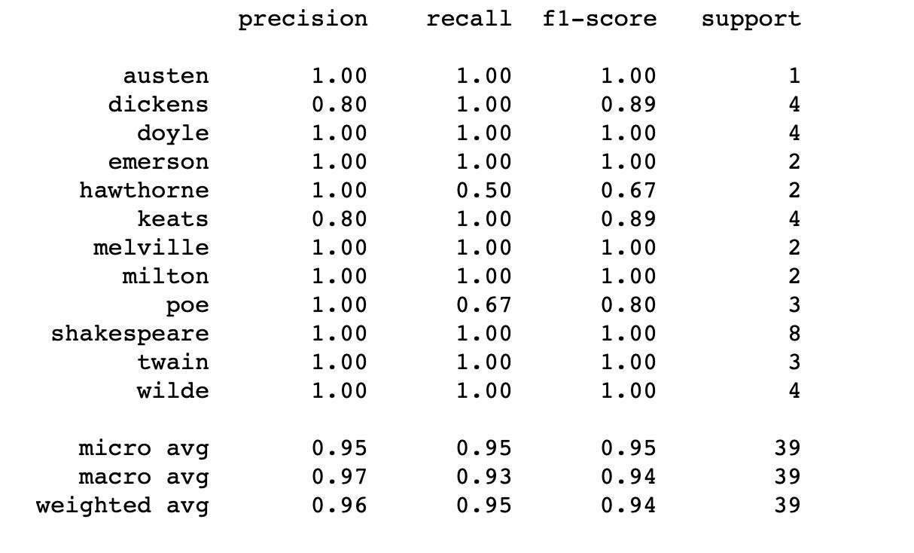
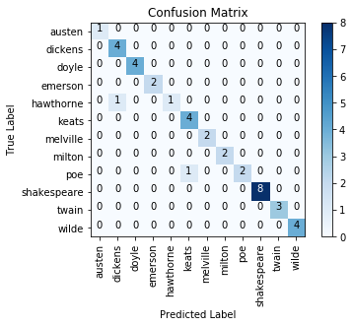
SVC - Linear Kernel with no tuning
Notes:
CV of .89

Slide 14
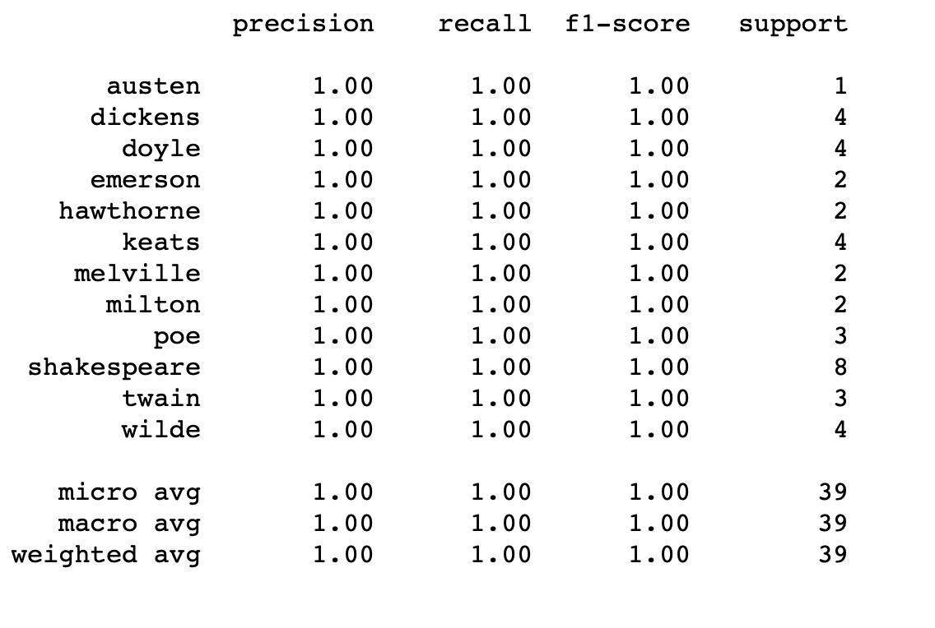
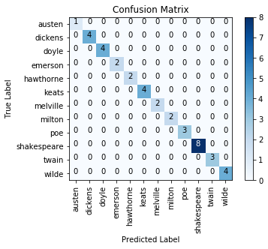
SGDC - Squared Loss Regression/Tuned
Notes:
CV .93 5 folds

Slide 15
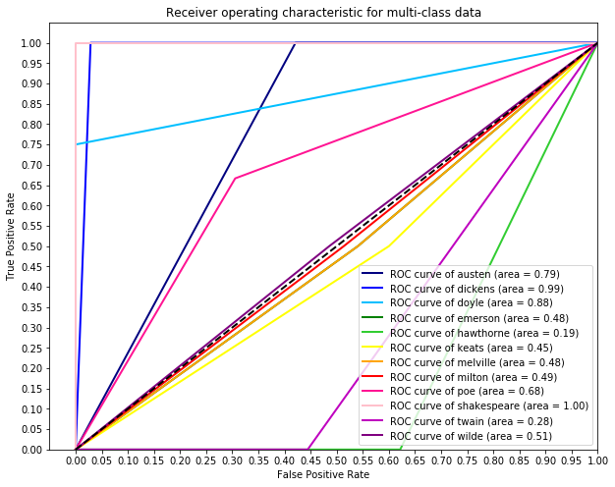
SGDC - ROC/AUC

Slide 16
SGDC - Parameters
Loss = “squared_loss”
learning_rate="adaptive"
Eta0 = .41
max_iter=250
penalty='l2'

Slide 17
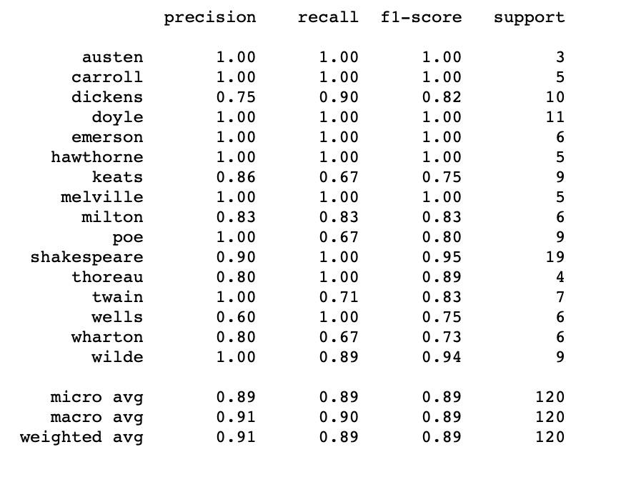
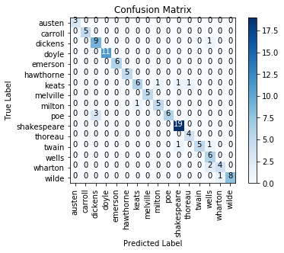
SGDC with Extra Data
Notes:
.915

Slide 18
Things that we did to make our models work better
We used TF-IDF, but all of our models ran better with just TF and without IDF. We believe that is because the authors that we chose had unique vocabularies. So just looking at the TF was enough to differentiate between authors.
N-grams (bi and tri) also did not improve the model.
Our data was also easily linearly separable, making it easy to classify.

Slide 19
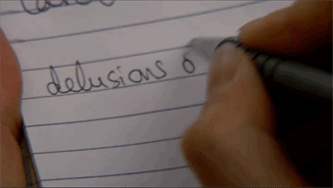
Having some fun - because why not?
Classifying Instructors and TCFs as authors from their slack posts:
FangFang - Milton
Taylor - Poe
Vishal - Milton

Slide 20
Conclusion
Our best model was SGD-R with a testing F-1 score of 1.0 and a cross validation score of .93 across 5 folds.
It still performed well when we added additional data.
We are able to pretty accurately predict the author based on their work.
However, it would be interesting to see how the model runs with authors who are more contemporary and similar to each other (or authors who are friends and commonly write books together ie Neil Gaiman, Terry Pratchett, and Douglas Adams)
There are tons of great books on Project Gutenberg, so we can all still read while we are broke.

